Slide 1

Capstone Project
By Ragavendran G

Slide 2



Personal BACKGROUND
(Name, Past Experience, Qualification, Career Summary)
Name : Ragavendran G
Past Experience : Fresher
Qualification : B.tech -Information Technology
Career Summary : I have completed my Bachelor's degree in Information Technology. I am currently focusing on enhancing my skills in backend development using Java and Spring Boot, and I am committed to learning and working efficiently.
www.collaberadigital.com

Slide 3


Problem Statement of the Capstone Project
In the modern digital era, online shopping has become an integral part of everyday life. Consumers increasingly prefer the convenience of shopping from their homes over traditional Retail Store. However, many existing online shopping platforms still face significant challenges that impact user experience and business efficiency.
Complex User Experience: Many online shopping websites and applications have complex interfaces that can users, especially those who are not tech-savvy. Difficult navigation, convoluted checkout processes, and poorly organized product listings can lead to frustration and cart abandonment.
Many platforms struggle to scale with business growth, causing performance issues and potential downtime as traffic and transactions increase.
Implementing robust security measures is challenging, leading to risks of data breaches and compromising customer trust.

Slide 4
Problem Statement of the Capstone Project
Lack of Integration: Many existing systems do not integrate well with payment gateways, shipment tracking, and customer relationship management tools. This lack of integration can create gaps in the shopping experience and complicate order fulfillment processes.
The objective of the online shopping system project is to address these challenges by developing a comprehensive solution that provides:
User-Friendly Interface: An intuitive and user-friendly interface that simplifies navigation, product search, and the checkout process, enhancing the overall user experience.
Efficient Product Management: A streamlined product management system that allows for easy updates, real-time inventory tracking, and accurate pricing information.
Seamless Integration: Integration with various third-party services, including payment gateways, shipment tracking, and customer relationship management tools, to provide a good shopping experience.

Slide 5

Key Takeaways/Learnings from the Program (HTD)
I previously knew how to work on the frontend of websites, but now I also know how to work on the backend, connect with a database, and ensure seamless communication between the frontend and backend.
Using Spring Boot, I developed a robust backend for my online shopping system, incorporating features like dependency injection, RESTful APIs, and transaction management.
I gained experience in using annotations, configuring entities, and managing their relationships in the database.
Implementing JPA/Hibernate, I learned to manage one-to-one, one-to-many, and many-to-one associations, effectively mapping these relationships in the database schema.
By handling exceptions and validating inputs, I enhanced the application’s robustness, ensuring a smoother user experience by anticipating and managing potential issues.

Slide 6
Project Synopsis
1. Spring Boot
Spring Boot Overview
Spring Boot is a framework designed to streamline the development of applications based on the Spring framework.
Simplified Configuration and Setup
Spring Boot automatically sets up critical components such as data sources, entity managers, and web servers according to your project's dependencies. This minimizes manual configuration and accelerates development.
Configuration settings can be managed centrally in application.properties or application.yml, simplifying the setup of database connections, logging, and other parameters.
How Spring Boot Enhances My Project
It provides a clear structure and conventions, making the application easier to maintain and understand.
It supports simpler testing and deployment with embedded servers and integrated testing frameworks.

Slide 7
2. Hibernate Overview
Hibernate is an open-source
Object-Relational Mapping (ORM) framework for Java that simplifies database operations by mapping Java objects to database tables, allowing developers to use Java objects rather than S
@Entity: Marks the class as a database entity.
@Id: Specifies the entity's primary key.
@GeneratedValue: Defines how the primary key value is generated.
@OneToOne: Sets up a one-to-one relationship between entities.
@JoinColumn: Specifies the column used for joining tables in the database.

Slide 8
Jpa repository offers standard CRUD operations and additional features without requiring manual implementation.
@Service: Marks the class as a Spring service component.
@Autowired: Simplifies dependency injection into Spring-managed beans, fostering loose coupling and easier testing. It supports field, constructor, and setter injection, and manages multiple beans and optional dependencies wiith @Autowired, developers can concentrate on business logic while Spring handles dependency management complexity.
@RestController: Defines a controller for RESTful services.
@RequestMapping: Maps HTTP requests to handler methods.
@GetMapping and @PostMapping: Handle GET and POST requests, respectively.
spring.datasource.url: URL of your database.
spring.datasource.username and spring.datasource.password: Credentials for database access.
spring.jpa.hibernate.ddl-auto: Configures how Hibernate handles schema generation. update keeps the schema updated based on the entity classes.
Hibernate Overview

Slide 9
3. Exception Handling and Configuration Properties
Exception Handling
Spring Boot provides robust exception management features
Global Exception Handling: Centralized error management using @ControllerAdvice.
Custom Exceptions: Creation of specific exception classes for various error conditions.
Consistent Error Responses: Standardized error messages with an ApiError class.
Validation Handling: Built-in and custom handling of validation errors.

Slide 10
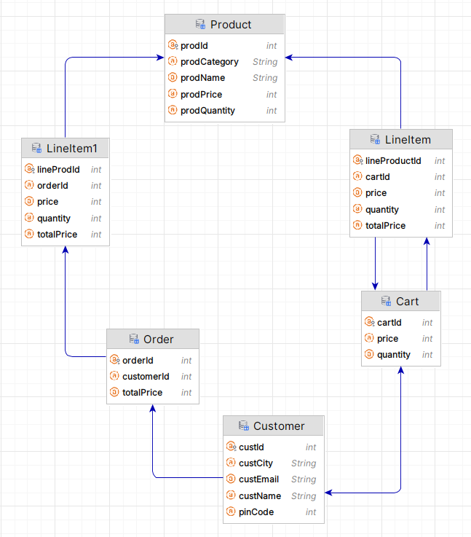
Class Diagram

Slide 11

Customer: Manages user-specific data and links to their cart and order.
Product: Stores details about items available for purchase.
Cart: Manages items a customer intends to buy and links to the customer.
Line Item: Represents individual items within a cart, including details like quantity and price.
Order: Represents completed transactions, aggregating line items into a final purchase.
LineItem1: Similar to Line Item but used in the context of completed orders.
Customer:
Relationships:
One-to-One with Cart: Each Customer has one Cart. This relationship is represented by @OneToOne with a @JoinColumn(name = "customer_cart") indicating the foreign key in the Cart table.
One-to-One with Order: Each Customer has one Order. This relationship is managed with @OneToOne(cascade = CascadeType.ALL), meaning operations on Customer will cascade to Order.
Purpose:
To store and manage customer-specific information

Slide 12

Product:
Relationships:
Many-to-One with Line Item: A Product can be associated with multiple Line Items. This is managed by the @ManyToOne annotation in the Line Item class.
Many-to-One with LineItem1: A Product can be associated with multiple LineItem1s, which is managed similarly in the LineItem1 class.
Purpose:
To provide detailed information about products in the system.
Cart:
Relationships:
One-to-One with Customer: Each Cart is associated with one Customer, represented by @OneToOne(mappedBy = "cart"). This indicates that the Cart entity is mapped by the Customer entity’s cart attribute.
One-to-Many with LineItem: Each Cart contains multiple LineItems. This relationship is managed by @OneToMany(cascade = CascadeType . ALL, fetch = FetchType . EAGER).
Purpose:
To manage and store the products a customer intends to purchase.

Slide 13
CartLineItem:
Relationships:
Many-to-One with Product: Each LineItem refers to a single Product, managed by @ManyToOne.
Many-to-One with Cart: Each LineItem belongs to one Cart, also managed by @ManyToOne.
Purpose:
To maintain details such as quantity, price, and total price for each product in the cart.
Order:
Relationships:
One-to-Many with LineItem1: An Order contains multiple LineItem1 entries. This is managed by @OneToMany(cascade = CascadeType.ALL, fetch = FetchType.EAGER).
Purpose:
To track completed orders and their associated details.
OrderLineItemList: Relationships:
Many-to-One with Product: Each LineItem1 refers to a single Product.
Many-to-One with Order: Each LineItem1 belongs to one Order.

Slide 14
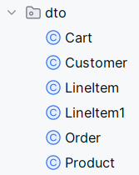
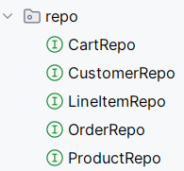
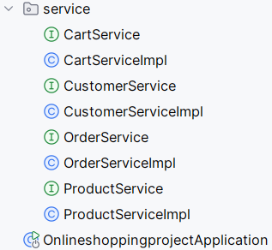
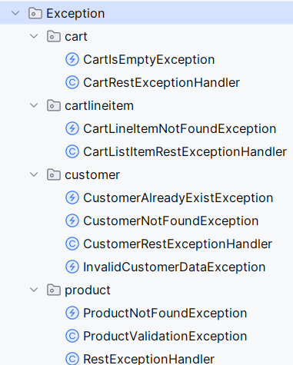
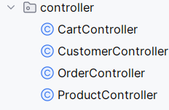
Important areas of the Project with screenshots
Pojo Package
Repository
Package
Service Package
Exception Package
Controller Package

Slide 15
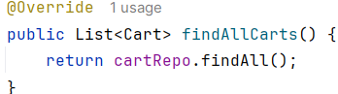
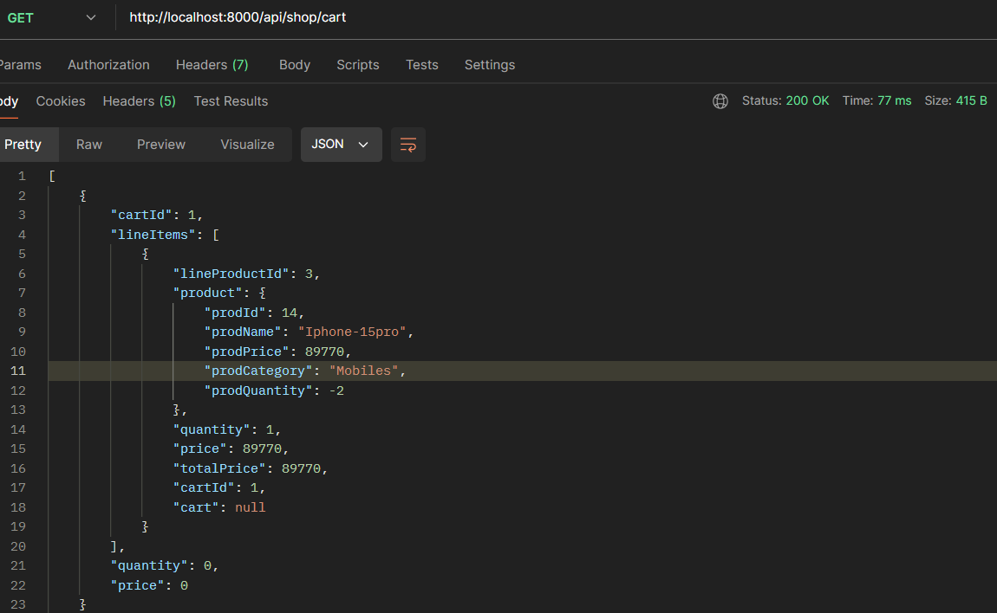
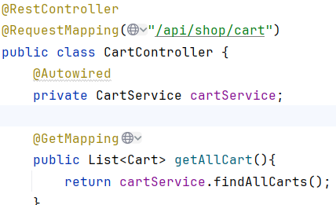
Important areas of the Project with screenshots
View all Cart

Slide 16
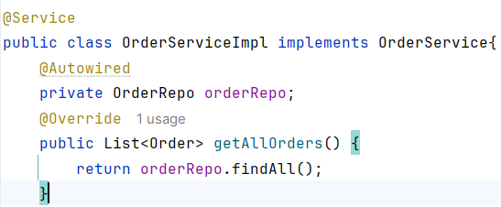
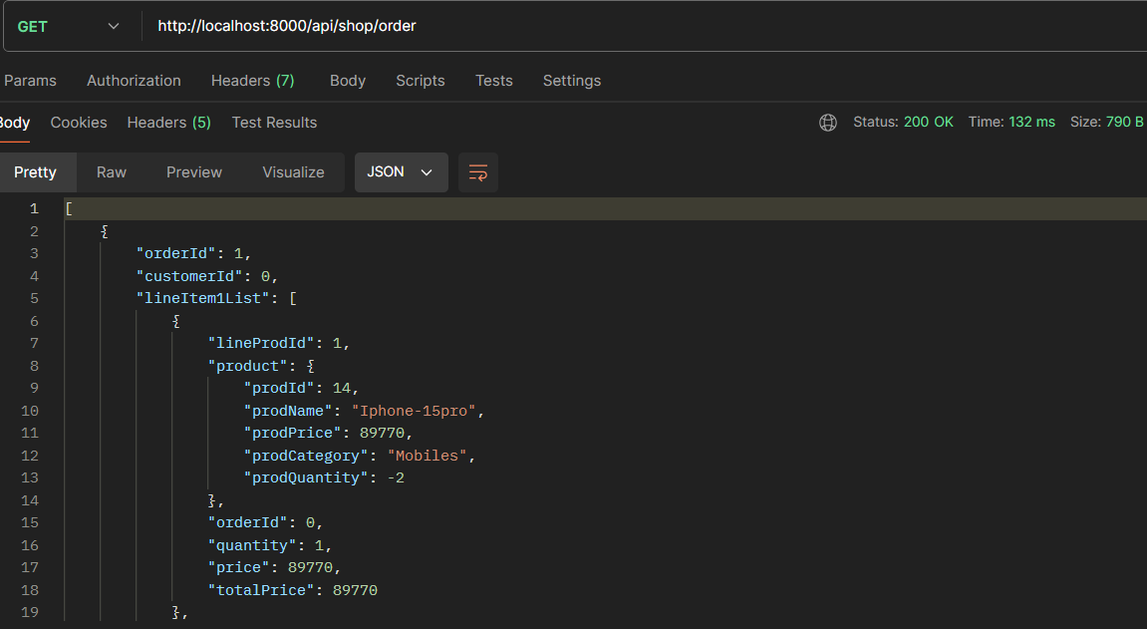
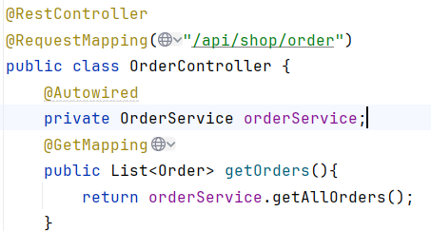
Important areas of the Project with screenshots
View all Orders

Slide 17
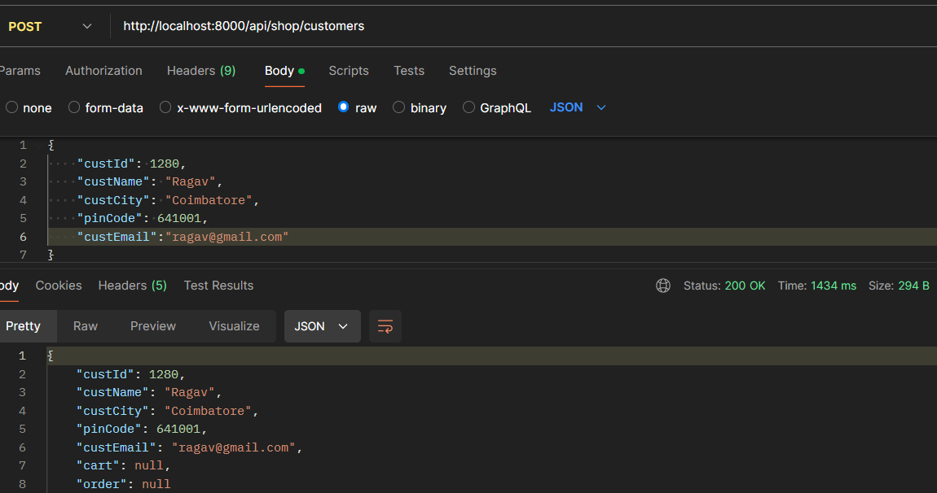
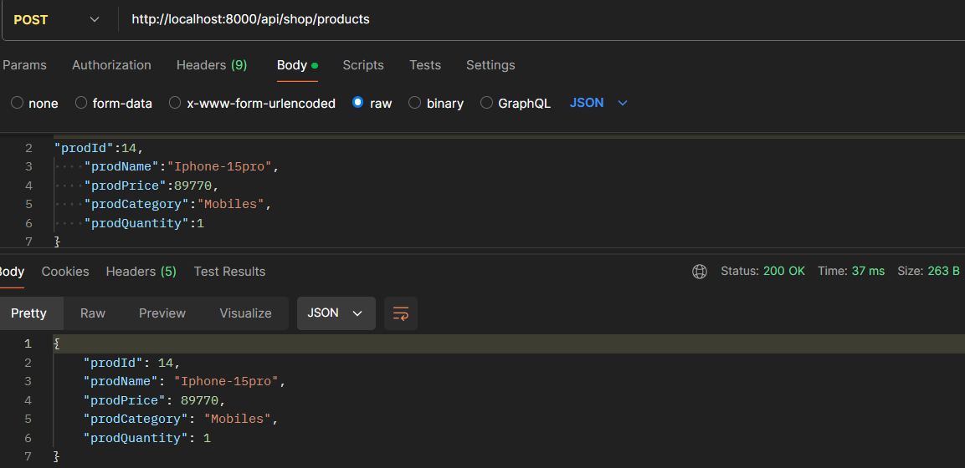
Important areas of the Project with screenshots
Add a Customer
Add a Product

Slide 18
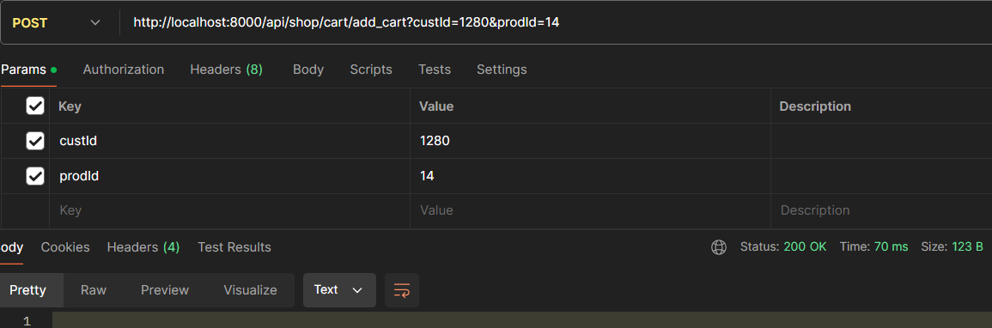
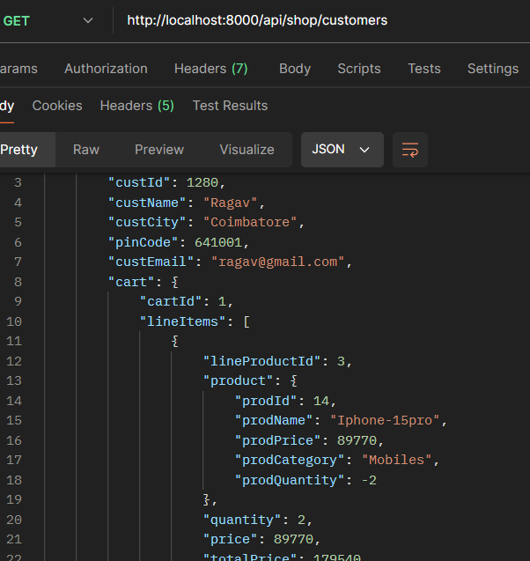
Important areas of the Project with screenshots
Add a Product to Cart
Get a Customer , cart should be Added

Slide 19
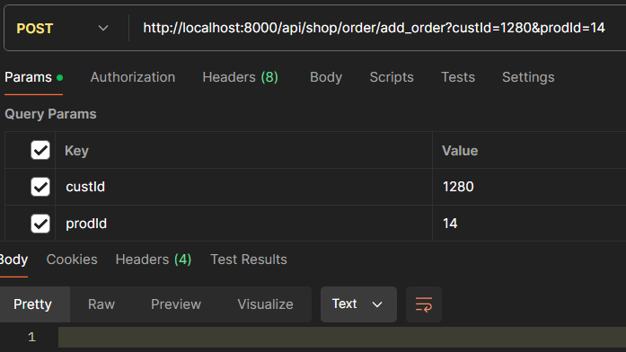
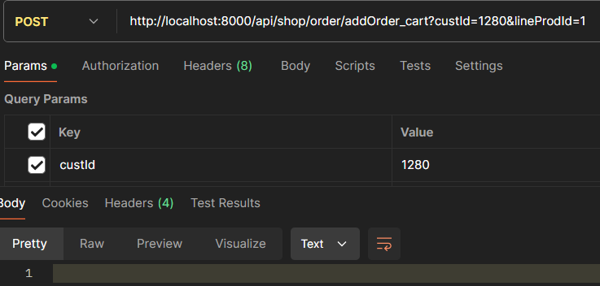
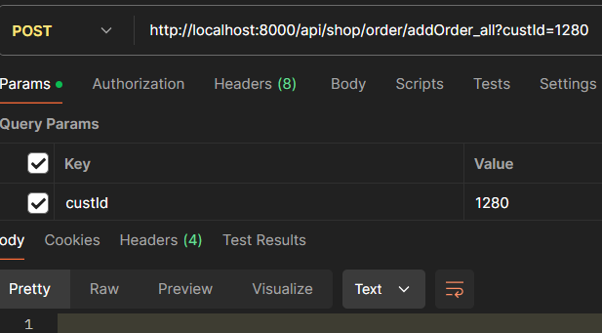
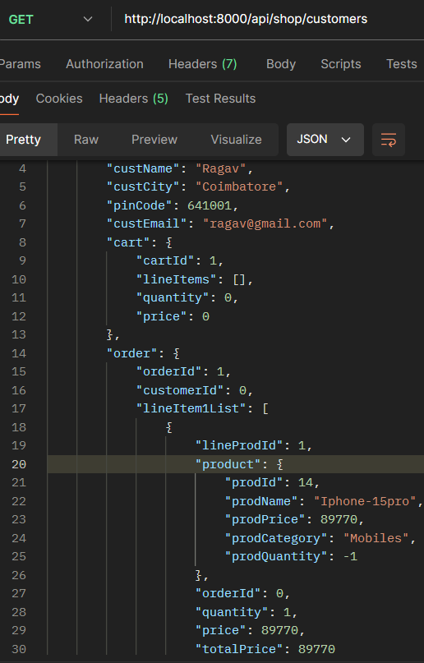
Order a Product in three ways
Order a product directly(Buy Now) Order a product from cart Order a Product from Cart(buy all)
After placing an order, the products in the cartlistitems should be removed, leaving the cart empty, and the order should be processed successfully.

Slide 20
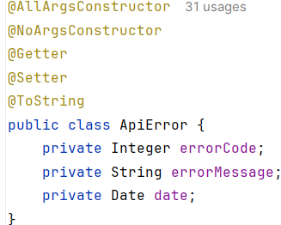
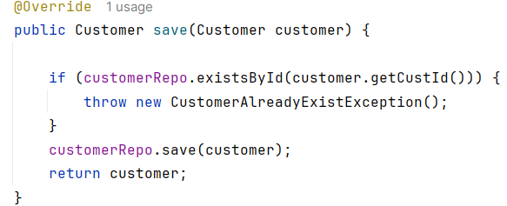
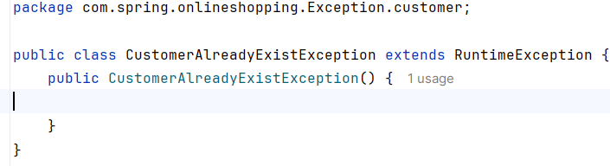
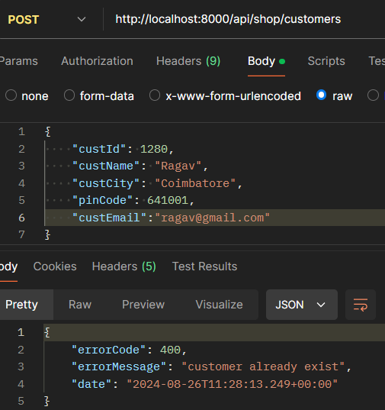
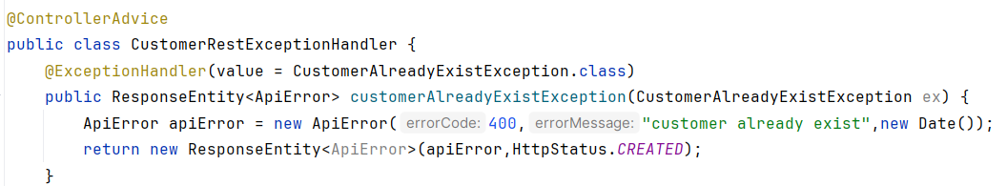
Exception

Slide 21
The online shopping project successfully leveraged Java Spring Boot and Hibernate to create a scalable, maintainable, and user-friendly application.
This Following best practices in object-oriented design, exception handling, and architectural patterns, the project is a solid foundation for understanding and developing modern web applications.
The experience gained through this project will be valuable in tackling more complex challenges and continuing to enhance development skills in future projects.
Conclusion

Slide 22
Thank You

